Slide 1
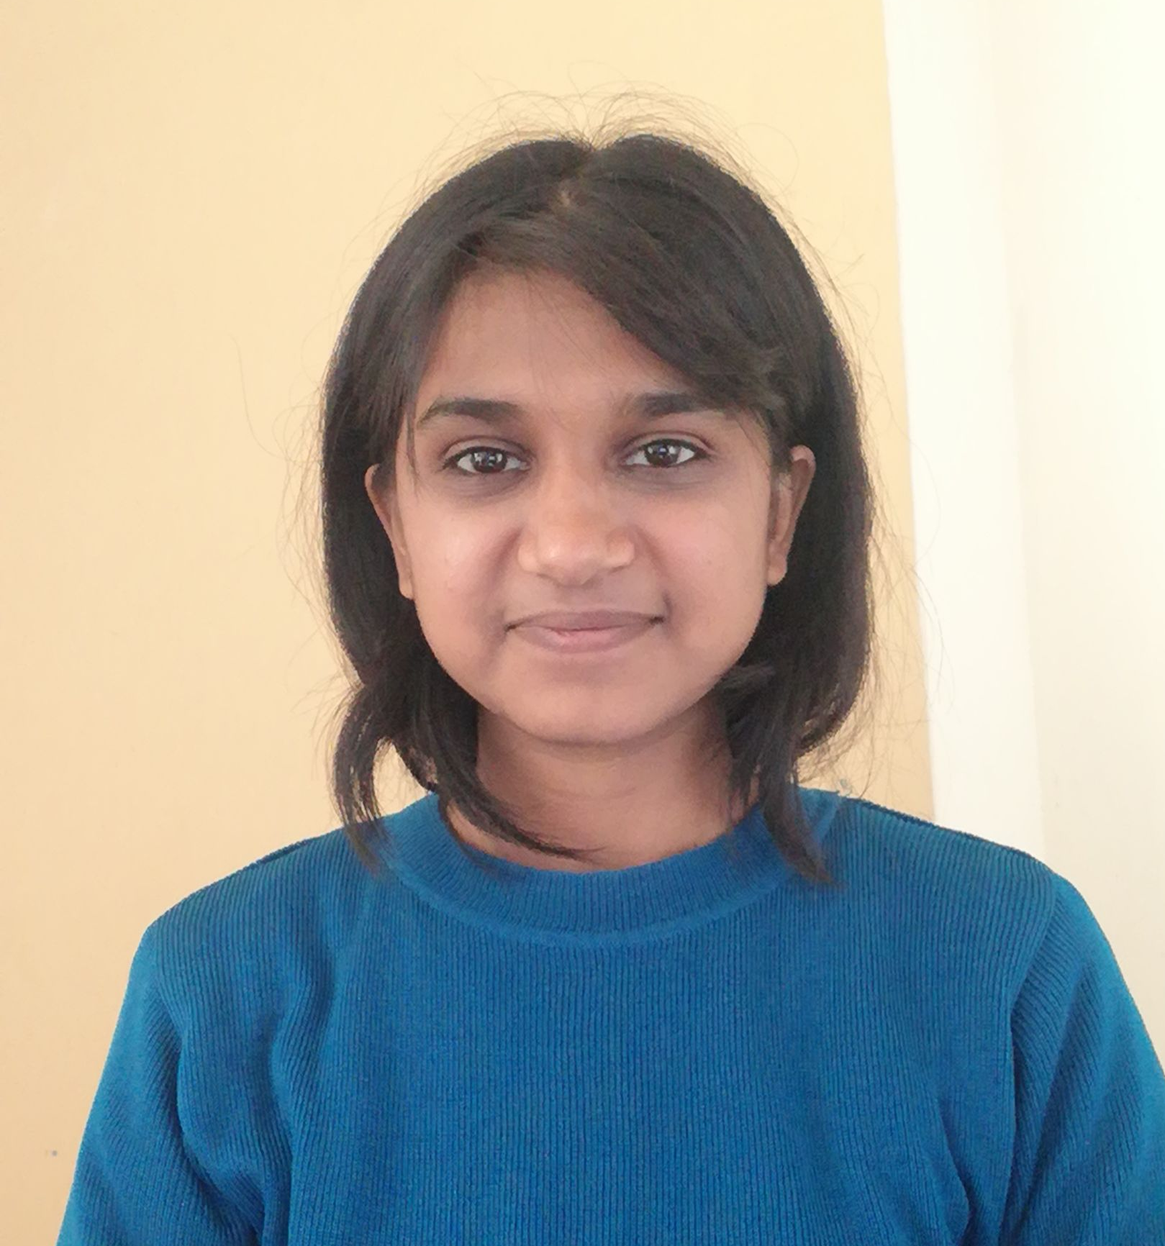
All about me…
Anjali Vashisth
Data Engineer – Danske IT
B.Tech. CSE – V.I.T, Vellore

Slide 2



Life
Childhood
Been in different states
Introvert
More into studies rather than Extra Curricular
Loved Designing stuff
College
Became social butterfly
Studied and participated
Hosted and organized events
Formed a club
People who have Influenced
Family
Friends
Colleagues
Living with experiences of mine and theirs's to learn from them.
“The Purpose of Our Lives is to be Happy” – By Dalai Lama

Slide 3


School and College
Dayanand Anglo Vedic School, Faridabad
9.8 CGPA in CLASS 10TH
92 % in CLASS 12TH
Silver Medallist in National Computer Olympiad 2016 -School
Gold Medallist in National Computer Olympiad 2017 -School
Scholar Coat Holder
Vellore Institute of Technology
8.96 CGPA
Won – Best Women’s Team – Women Techies – Hackathon
Published – 2 Papers –
LIMAP: A Lightweight Multilayer Authentication Protocol for WBAN | SpringerLink - Developed Cyber Security Multilayered Algorithm for Authentication and Authorization safely
GCN embedded with Polynomial Aggregation Function for Group Activity Recognition | IEEE Conference Publication | IEEE Xplore- Recognized sports Activities via Image Processing and Al from video clips
All academic Information you might want to know

Slide 4

Beliefs and Skills
NATURE
Gave Speeches for Saving Environment.
Founder of an Organization – “Vriksh” now Club in VIT
Volunteered in Red Cross Club
ACTIVENESS
Organised and Volunterred in Several events in ComicCon, Creativity club, Animation Club, Red Cross, NCC.
Skills:
Team Spirit
Leadership
Creativity
Organizational skills
Technical Skills-
Data Structure and Algorithms
Coding- Python, Java(From college)
SQL, ETL Tools (From Job)
HTML, CSS ({Project)
DETERMINATION
2 Papers Published
Have won Women Techies Hackathon,
Rank 98 in Code Gladiators,
HAPPINESS
Been on Stage for Solo on the spot Dance, Singing, Speech.
4

Slide 5

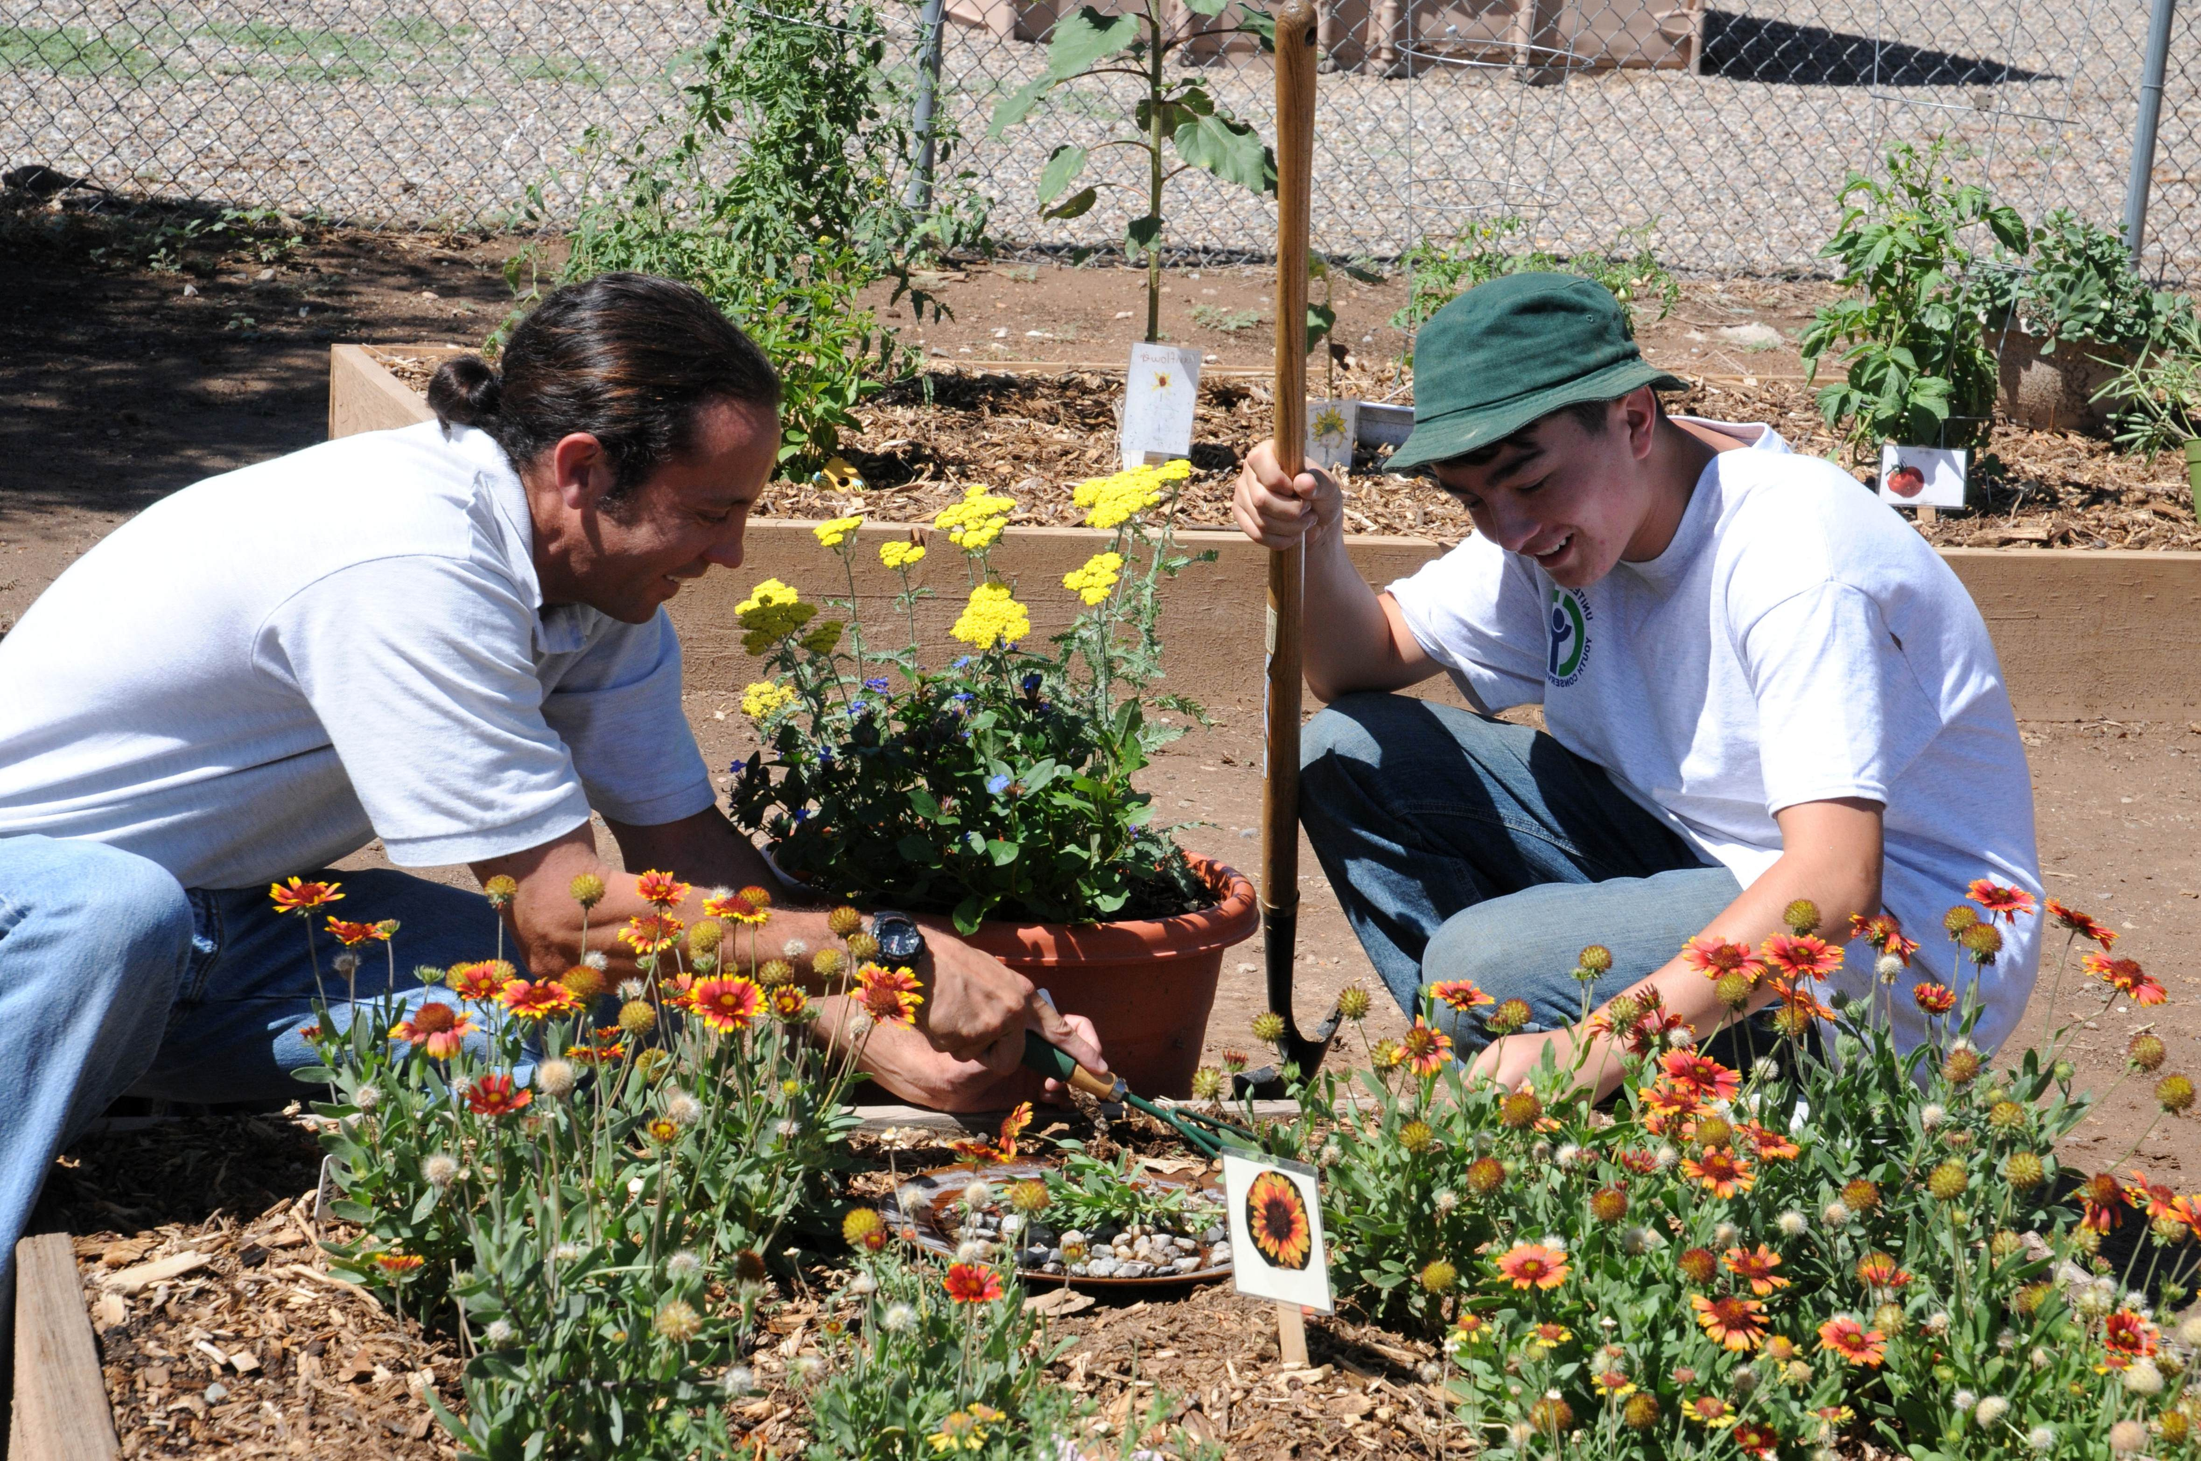

Connect between Life and Coding
KITCHEN
Abstraction,
Encapsulation,
Inheritance,
Polymorphism
GARDENING
Error Handling- Checked and Unchecked
CUPBOARDS
Organizing
using
Data Structures
Any Algorithm or the Operation we follow is linked or been grabbed from our every day life. Like when we are searching for the shortest path – we apply an algo only in our minds.

Slide 6
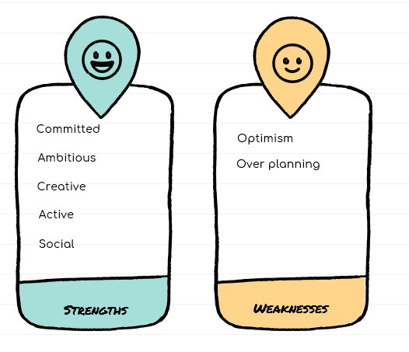
Strengths and Weakness'

Slide 7


Projects and Certifications
“A lightweight multilayer authentication protocol for WBANs”
A certificate less authentication protocol using two layers of Algorithms applied using Elliptical equations and Hashing with a team of 3
“Handling Lost and Found using AI”
Web and mobile application formed for finding one’s lost item apply AI. We used PHP, SQL, Wamp server and React for the project with a team of 2
Projects
HTML, CSS, and JavaScript for Web Developers from Johns Hopkins University, Coursera
Machine Learning from Stanford University Coursera
Interactive Computer Graphics from The University of Tokyo Coursera
Certifications

Slide 8
Work
Built an Application for auto generation of mail for vendors for logistics. Along with authentication and authorization
SONY
Participated in app development using React Native Gave UX/UI Feedback
ALISTE
-Detail-oriented and motivated to stay on task.
- Meet timelines and accomplish goals.
- Analytical and organizational skills.
- Self-motivated and multitasking skills
Source Data using SQL and Hadoop Ingestions Reduced Ingestion process work through Automation Built project using Spring Boot Hibernate Organized and participated Cultural Activities
DANSKE IT

Slide 9

Why chose Amazon ?
Reputed Company
Its process of Optimising and Adding services Always
Its way for Modern Technology
Want to learn and experience the Corporate Culture in Amazon
Being a customer and the servicewomen
Want to expertise my skills.

Slide 10
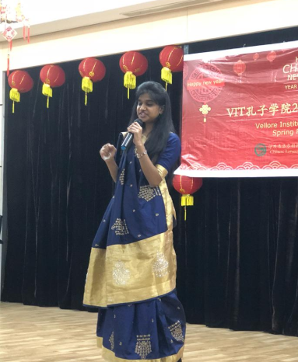
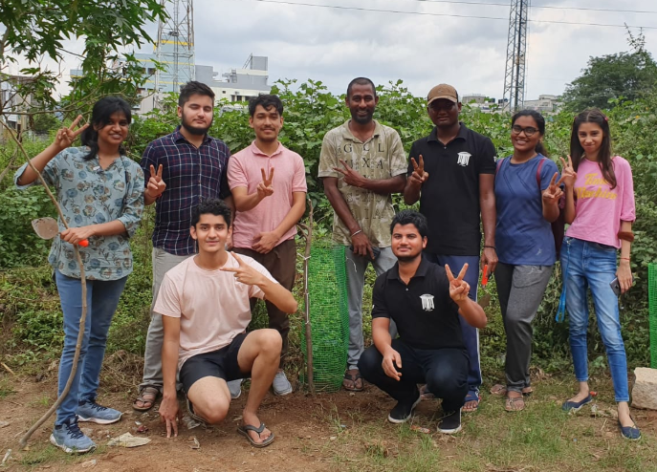
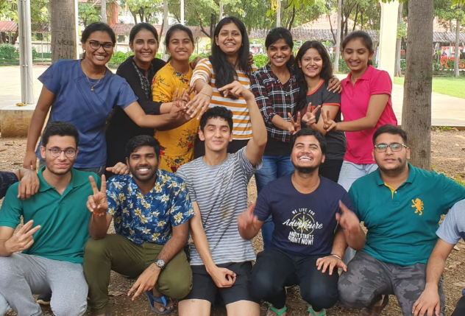
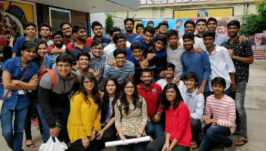
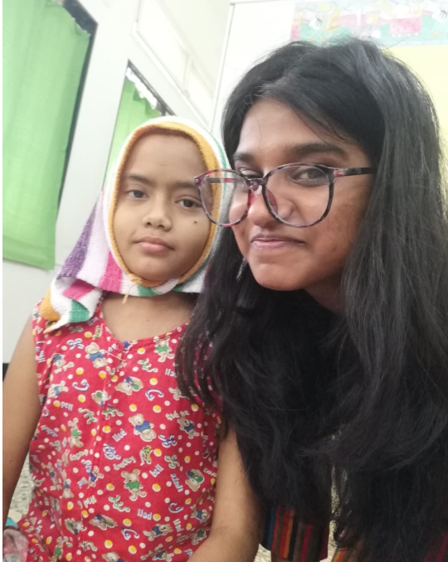
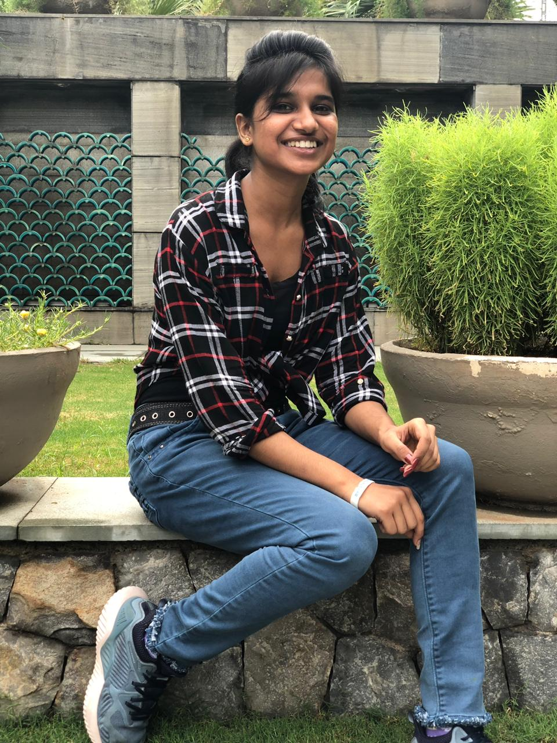
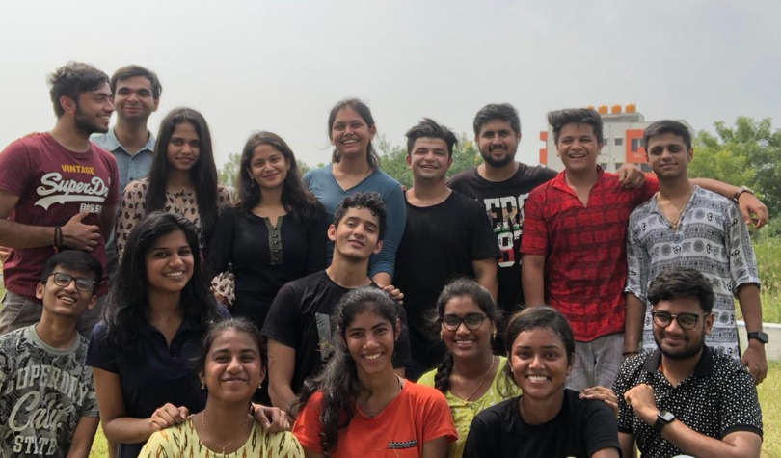
My life at VIT

Slide 11

THANK YOU
ANJALI VASHISTH
https://www.linkedin.com/in/anjalivash19231/

